Slide 1

B.Tech EXTC:
Yashvardhan Agarwal (C001)
Aditya Kamath (C021)
B.Tech CIVIL:
Bhakti Bhataria(G007)

Slide 2
INDEX
Scene Description
Scene Working
Objects Used
Flow of Scripts
Applications

Slide 3
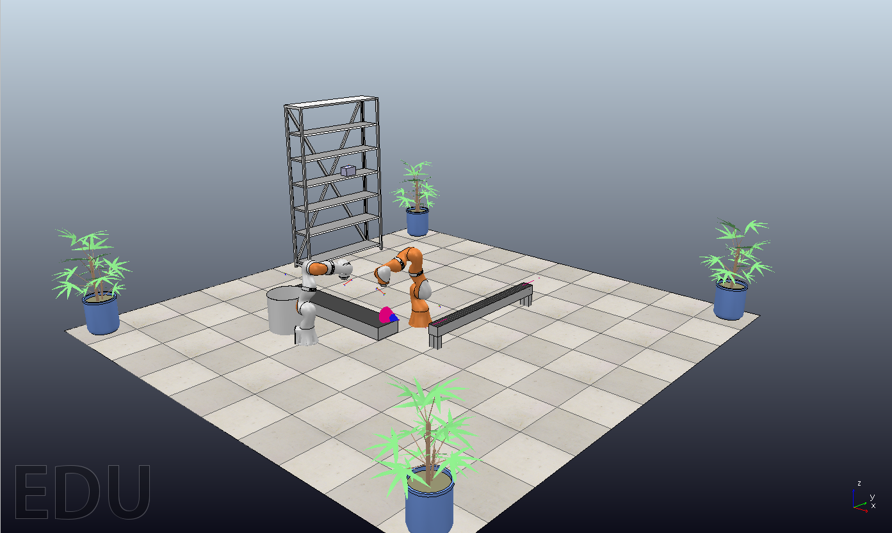
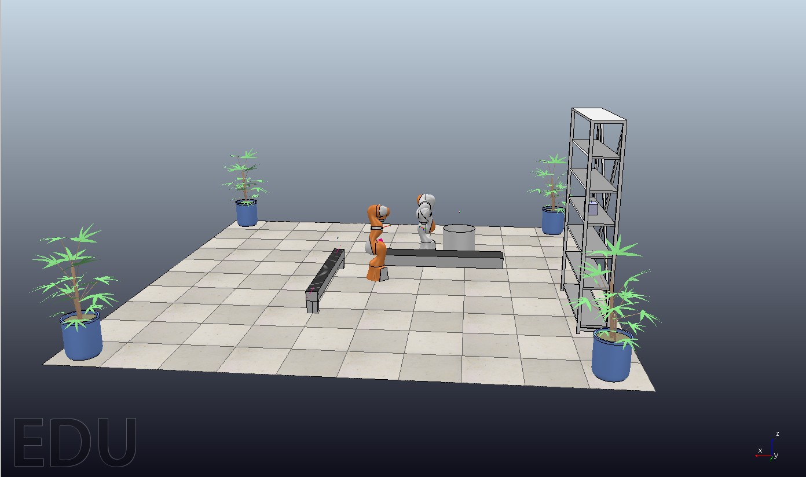
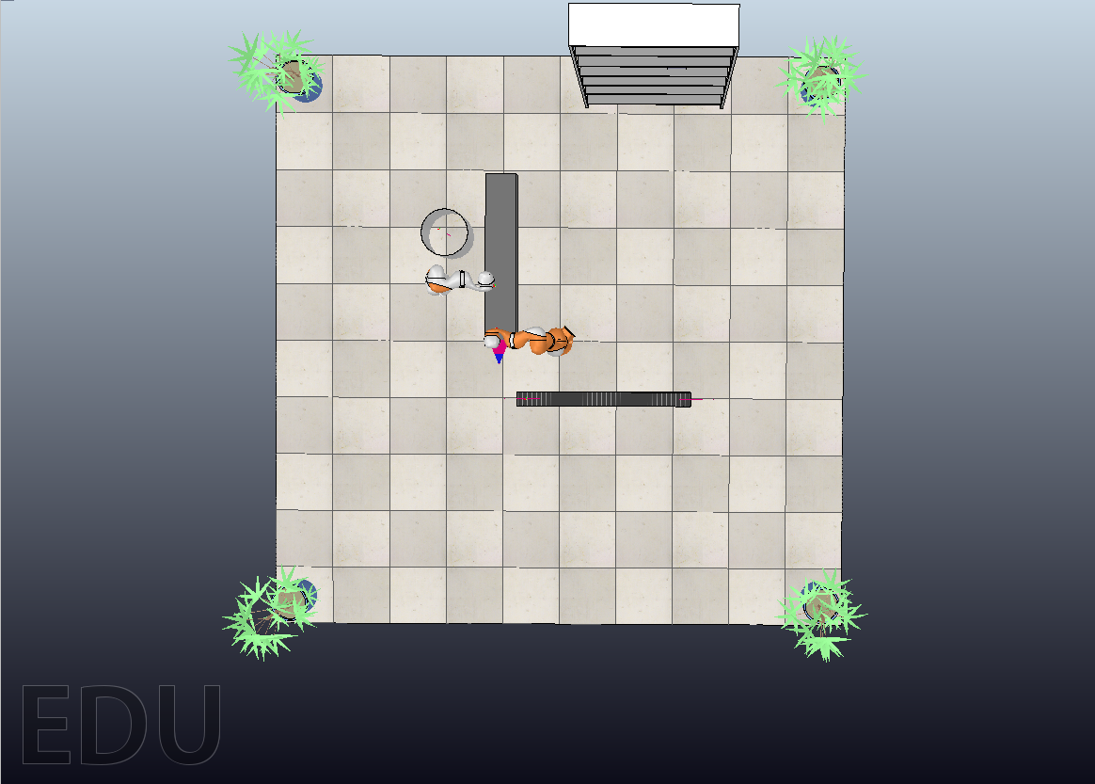
Scene Description
Side view 1
Side view 2
Top View

Slide 4
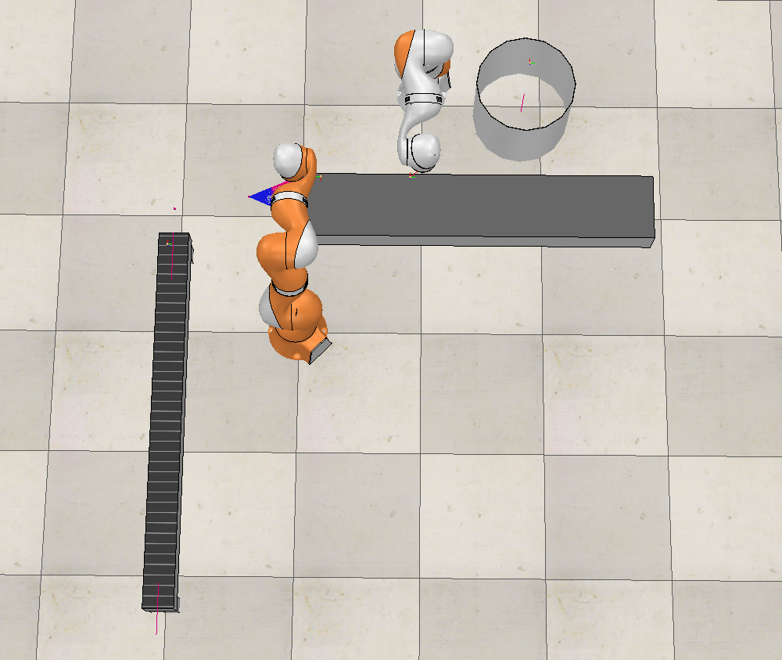
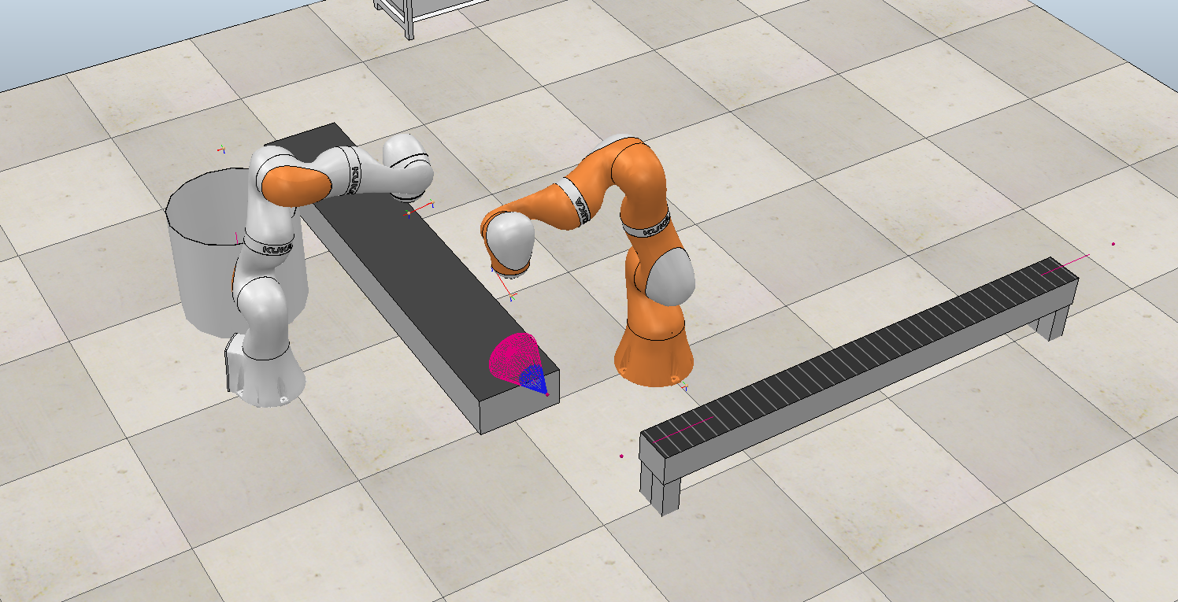
Scene Description

Slide 5
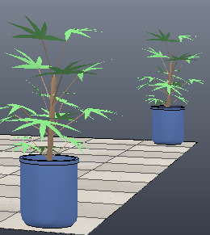
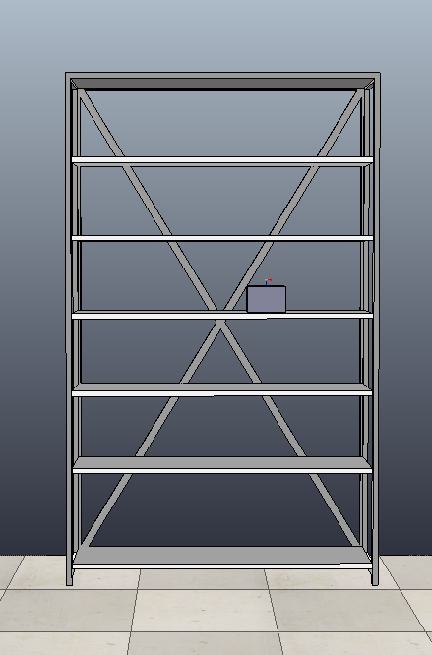
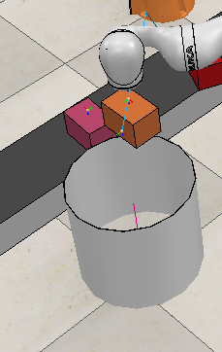
Objects Used
Plants
Rack
Bin

Slide 6
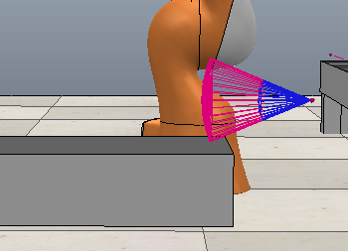
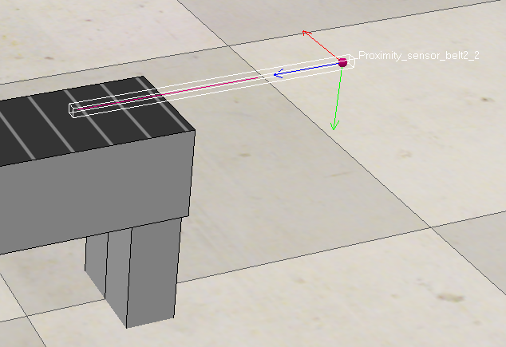
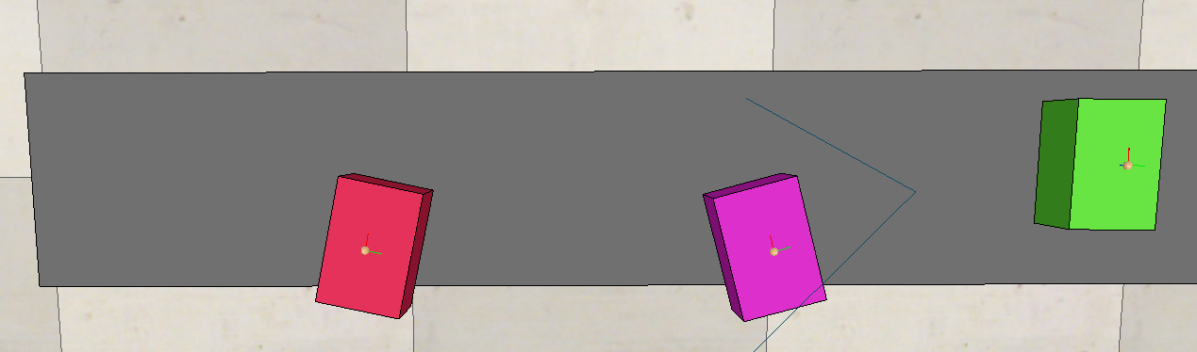
Objects Used
Box
Proximity sensor
Proximity sensor

Slide 7
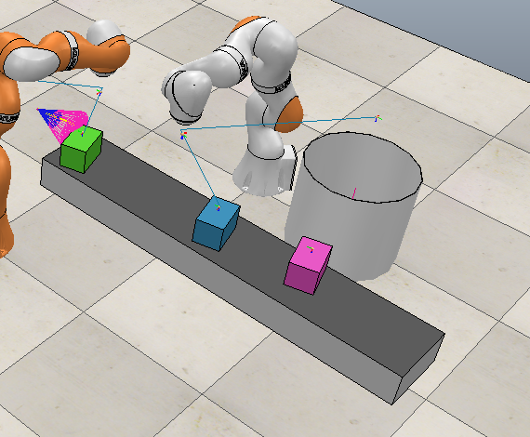
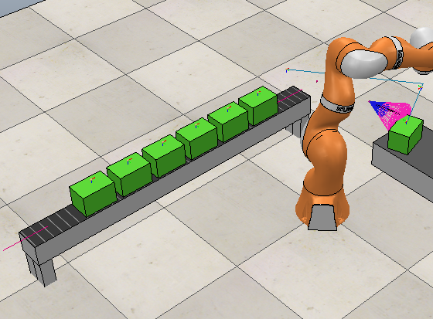
Objects Used
Conveyor Belt 1
Conveyor Belt 2

Slide 8
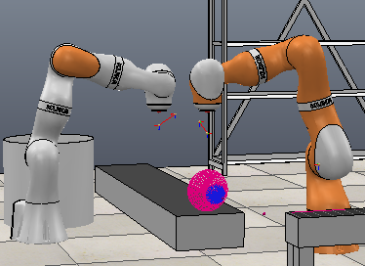
Robots
KUKA LBR iiwa 14R820
7 rotational joints
7 DOF
KUKA LBR iiwa 7R800
7 rotational joints
7 DOF

Slide 9
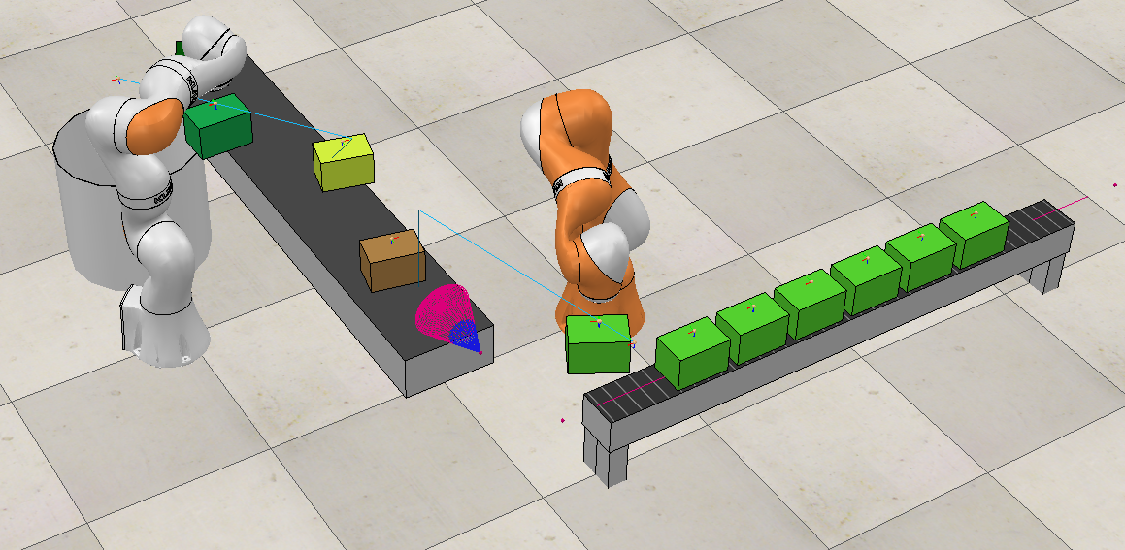
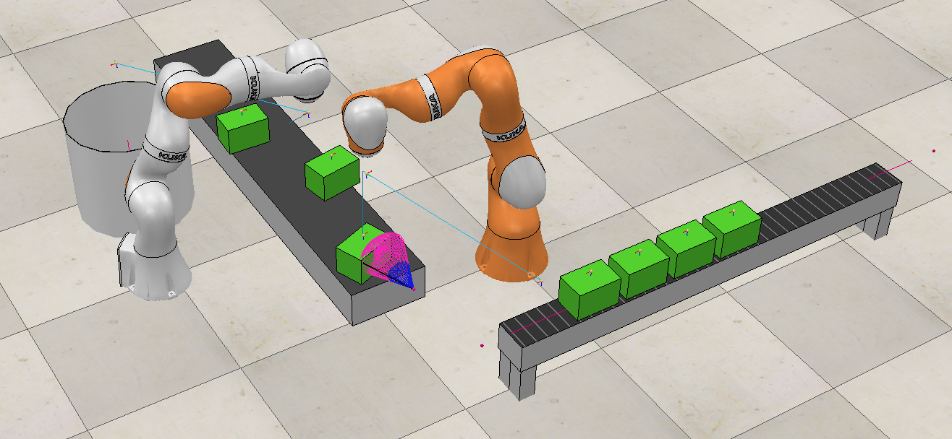
Scene Working
Generate Boxes of different color.
Place them at the start of conveyor belt in different orientation.
When desired color box arrives. stop the conveyor belt.
Robot 1 picks up the box and places it on next conveyor. Robot 2 picks up the different color box while the conveyor stops and places the box inside the bin.

Slide 10


Slide 11
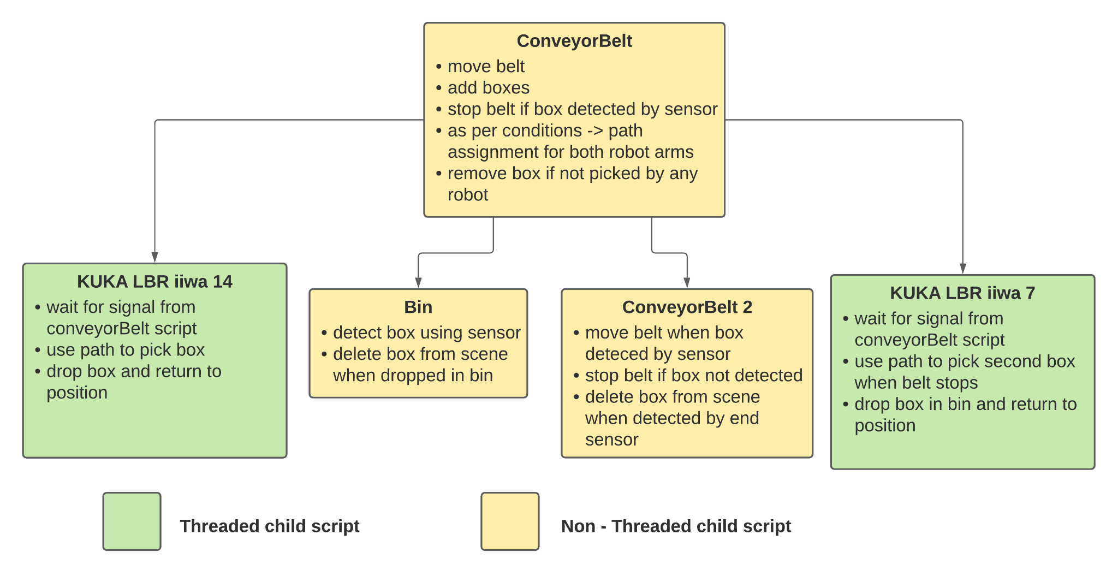
Script Flow

Slide 12
Application
Part sorting
Bin picking
Assembly
Packing
Inspection

Slide 13
Thank you

